Slide 1
ITU AI/ML in 5G Grand Challenge 2021
SOFGNN Team: Brigitte Jaumard^{1,2}, Junior Momo Ziazet¹, Charles Boudreau¹, Huy Duong²
¹ Computer Science and Software Engineering, Concordia University
² CRIM – Computer Research Institute of Montreal

Slide 2
Motivation: Automated 5G & B5G Networks
5G/B5G networks
Expected to be very complex, however very flexible and dynamic
High need to be managed automatically for optimized QoS performance and the QoE perceived by users
Machine Learning (ML) monitoring and control of network resources in order to predict and avoid SLA violations
Critical requirements for 5G
user´s perspective
network performance perspective
5G service classification systems use ML for prediction
KPIs (Key Performance Indicators) define the main factor when performing the ML classification, and
KQIs (Key Quality Indicators) reflect the performance and quality of End To End (E2E) services
In order to optimize the performance of 5G networks

Slide 3
Solution Overview
Goal: Improve GNN performance through design of scale-independent features and scale-independent output
Ideas:
Keep RouteNet[1] design with:
Our own GNN architecture
Our own message passing scheme
Address OoD data with :
Feature design
Address OoD output with :
Output transformation

Slide 4
Overview of Contributions
Feature Design
Elaboration of “link load” feature
Output Transformation
Queue occupancy as predicted value, from which delay is inferred
GNN Design
Modifications to architecture
Hyperparameter tuning

Slide 5
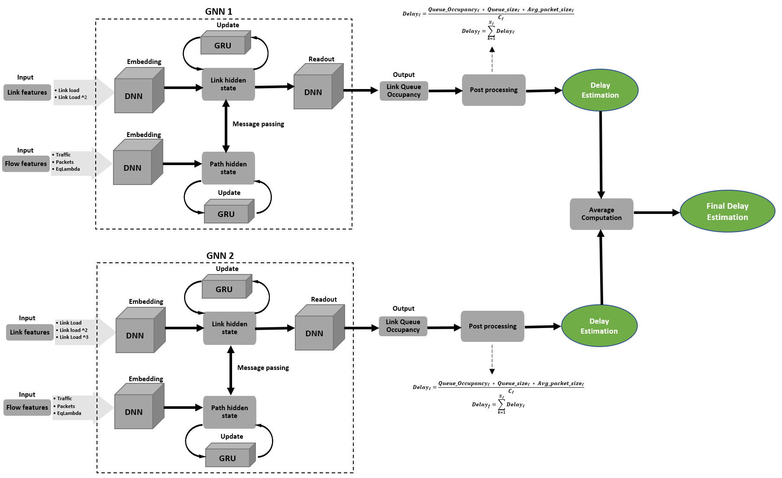
Solution Model

Slide 6
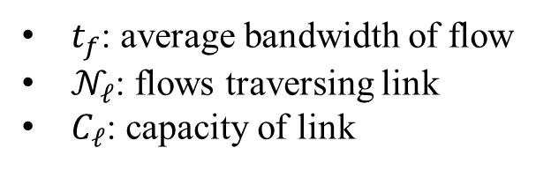
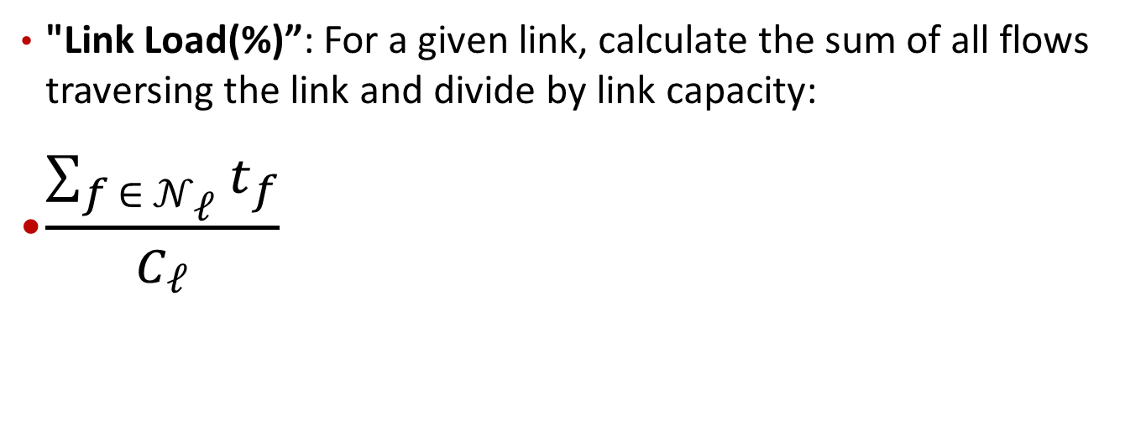
Our Contribution: Feature Engineering
Flow Feature | Model 1 | Model 2
Traffic | X | X
Packets | X | X
EqLambda | X | X
Link Feature | Model 1 | Model 2
Link Load | X | X
Link Load² | X | X
Link Load³ |  | X
"Link Load(%)”: For a given link, calculate the sum of all flows traversing the link and divide by link capacity:
$\frac{\sum_{f ∈ 𝒩_{ℓ}}{t_{f}}}{C_{ℓ}}$
$t_{f}$: average bandwidth of flow
$𝒩_{ℓ}$: flows traversing link
$C_{ℓ}$: capacity of link

Slide 7
Our Contribution: Feature Engineering
Found replacing the “capacity” (Link Bandwidth) feature with “Link Load(%)” positively affects model accuracy
Cause: Model is not be able to infer this relation the Message-Passing/Aggregating
Also raised Link Load to second and third power, has a modest positive effect on accuracy for the current traffic loads
Explanation:
Further differentiation of heavily-used links from lightly used ones
Non-Linearities encoded as features may help generalization[2]

Slide 8

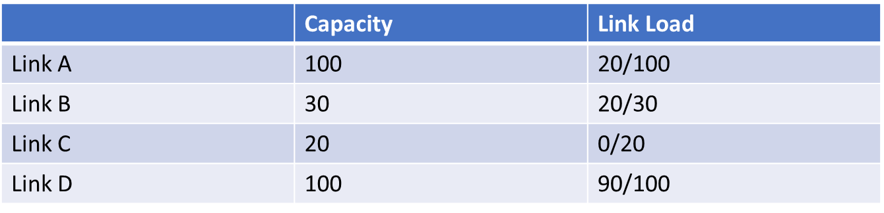
Link Load vs Capacity
Link D
Link C
Link A
Link B

Slide 9
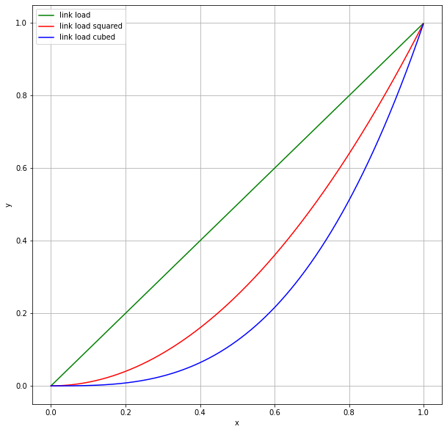
Exponential Link Load
Difference with link load

Slide 10
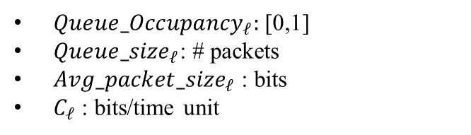
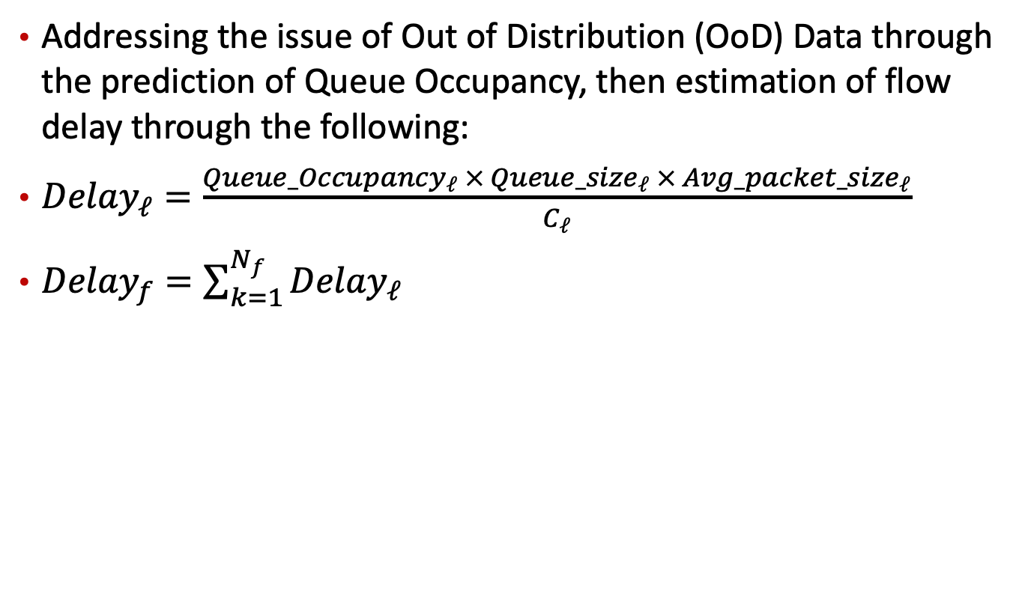
Selected Modelling of the Delay
Addressing the issue of Out of Distribution (OoD) Data through the prediction of Queue Occupancy, then estimation of flow delay through the following:
${Delay}_{ℓ}=\frac{{Queue_Occupancy}_{ℓ} × {Queue_size}_{ℓ} × {Avg_packet_size}_{ℓ}}{C_{ℓ}}$
${Delay}_{f}=\sum_{k=1}^{N_{f}}{{Delay}_{ℓ}}$
${Queue_Occupancy}_{ℓ}:$ [0,1]
${Queue_size}_{ℓ}$: # packets
${Avg_packet_size}_{ℓ}$ : bits
$C_{ℓ}$ : bits/time unit

Slide 11

Queue Occupancy and Delay
Red path Delay = 15+5=20 ms
queue time = 0 ms
queue time = 5 ms
queue time = 8 ms
queue time = 2 ms
queue time = 1 ms
queue time = 3 ms
green path Delay = 5+5=10 ms
queue time = 1 ms

Slide 12
Summary of Results
 | Updates/ changes | Models | Model 2 | Model 3 | Model 4 | Model 5 | Model 6 | Model 7 | Model 8: ensemble
 |  | 1 | 2 | 3 | 4 | 5 | 6 | 7 | 8
1 | Data augmentation |  | x | x
3 | Link load |  |  | x | x | x | x | x | x
4 | Link load square |  |  |  |  |  | x | x | x
5 | Link load cube |  |  |  |  |  |  | x | x
6 | Direct delay prediction | x | x | x
7 | Occupancy prediction |  |  |  | x | x | x | x | x
8 | Avg_packet=1000 |  |  |  | x | x
9 | Avg_packet=packet/traffic |  |  |  |  |  | x | x | x
10 | Tuning hyperparameters |  |  |  |  | x | x | x | x
11 | Ensemble |  |  |  |  |  |  |  | x
VAL MAPE (%) |  | ~300 | ~50 | ~45 | ~5 | ~2 | ~1.5 | ~1.4 | ~1.3

Slide 13
Model Hyperparameters
Hyperparameter
Link Hidden State Size | 128/128
Path Hidden State Size | 128/128
Readout Size | 128/128/128
Number of Message Passing Rounds | 12
Learning Rate | 0.001
Optimizer | ADAM
Loss | MAPE
Both models included in the final ensemble share these hyperparameters

Slide 14

Future Directions
Scaling:
Examine scaling for even larger topologies(500 nodes, 1000 nodes, and beyond)
Alternate models?
Different KPIs:
Fine-tune the model to predict other KPIs beyond delay (Packet Loss, Jitter, …)
Ensuring %G service quality entails predictable KPI performance assurance

Slide 15
References
[1] K. Rusek, J. Suárez-Varela, A. Mestres, P. Barlet-Ros, A. Cabellos-Aparicio, “Unveiling the potential of Graph Neural Networks for network modeling and optimization in SDN,” In Proceedings of the ACM Symposium on SDN Research (SOSR), pp. 140-151, 2019.
[2] Xu, K., Zhang, M., Li, J., Du, S. S., Kawarabayashi, K. I., & Jegelka, S. (2020). How neural networks extrapolate: From feedforward to graph neural networks. arXiv preprint arXiv:2009.11848.

